Slide 1
Variant Detection III: VCFtools and Platypus
Paul Hoffman
Does[0]Compute?
February 21st, 2017

Slide 2
Variant/Binary Call Format (VCF/BCF)
Developed by 1000 Genomes Project to avoid redundancy found in General Feature Format (GFF) files
File format for defining gene sequence variation
Basically a multidimensional table
Not to be confused with the vCard Format (also VCF)

Slide 3
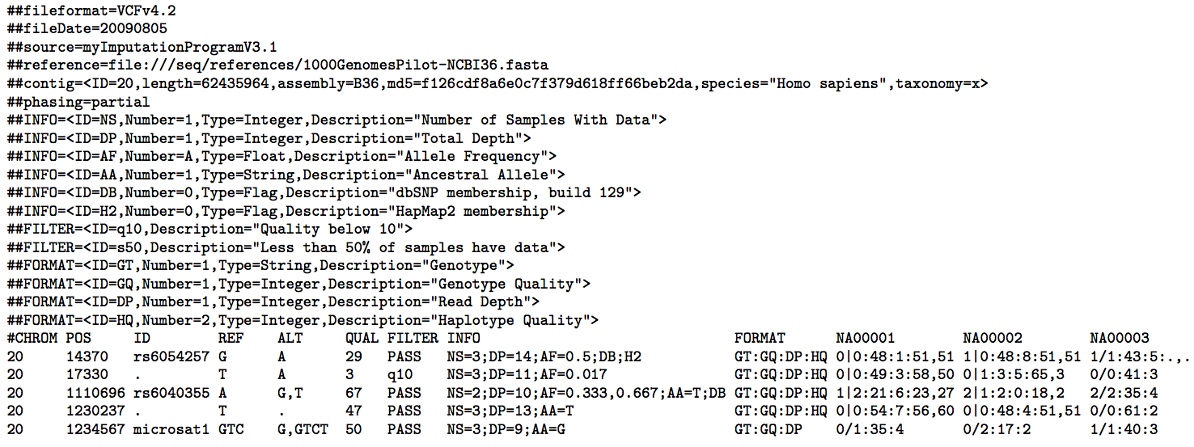
Variant/Binary Call Format (VCF/BCF)

Slide 4
Reference-based Variant Detection
Align sample to reference genome
Scan for systematic differences and identify haplotypes
High sensitivity and low resource requirements
Indels and large variants cause errors
Can be solved with realignment around indels
Realignment is computational costly
Fails in highly divergent regions

Slide 5
Reference-free Variant Detection
Build de Bruijn graphs to identify polymorphisms
Works well on divergent regions
Avoids need to alignment steps
Very computationaly expensive
Lower sensitivity than reference-based approaches
Fail with repetitive sequences

Slide 6
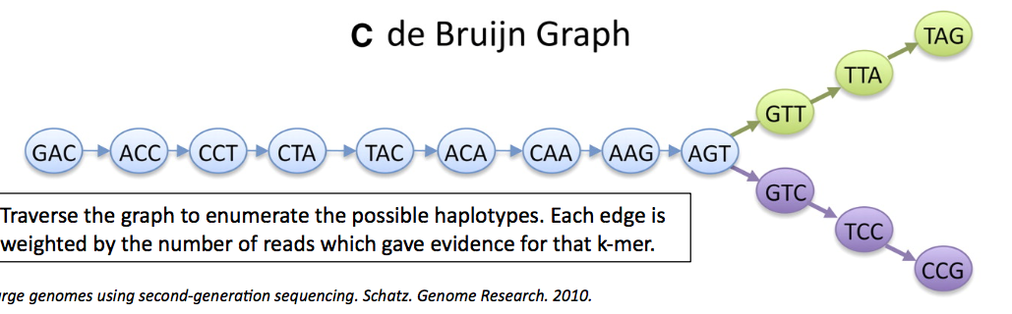
Reference-free Variant Detection

Slide 7
Platypus
A variant detection program from Wellcome Trust
Designed with four principles:
Variant detection algorithms should have high detective power
Programs should have low false discovery rates
Repetitive loci and local diversity should not be an issue
Computational requirements should be kept to a minimum

Slide 8
Platypus vs GATK HaplotypeCaller
Platypus
HaplotypeCaller
Accepts Heng Li's BAM/CRAM
Allows calling of variants across samples without intermediate files
Accepts Broad's BAM only
Accepts CRAM, but doesn't use CRAM's index
Requires intermediate files for multisample variant calling

Slide 9
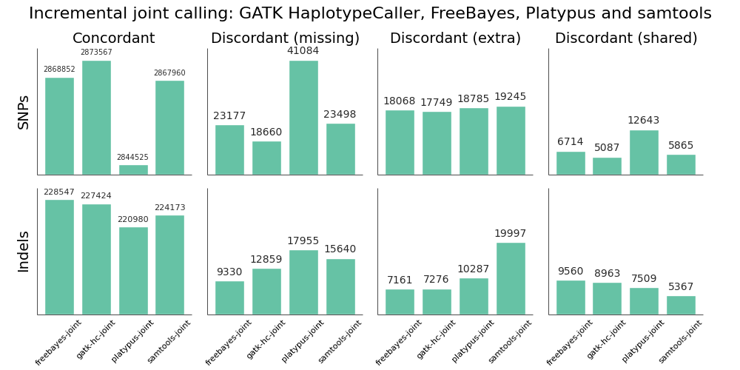
Platypus vs GATK HaplotypeCaller
Notes:
From Brad Chapman of Blue Collar Bioinformatics
Done with Human data
http://bcb.io/2014/10/07/joint-calling/

Slide 10
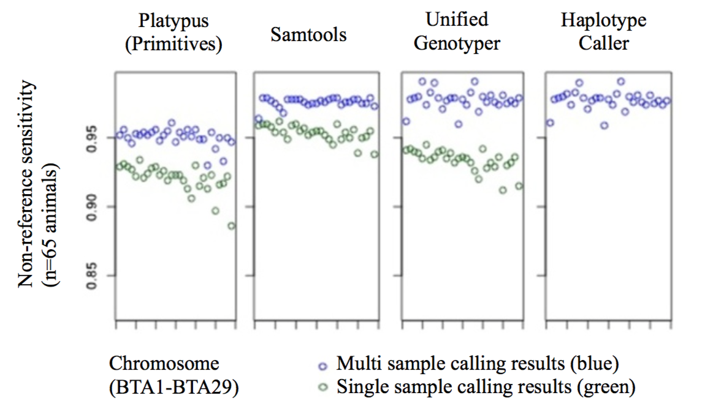
Platypus vs GATK HaplotypeCaller
Notes:
Baes et al 2014

Slide 11
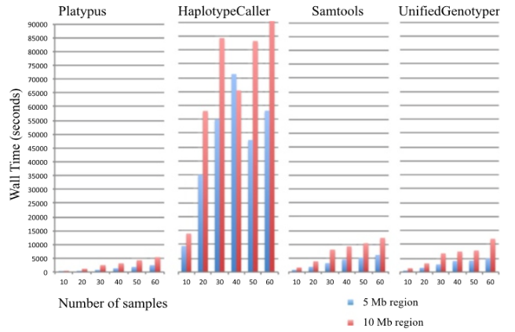
Platypus vs GATK HaplotypeCaller

Slide 12
VCFtools
A suite of functions to summarize, filter, and analyze genetic variation data in the VCF/BCF formats
Filtering acts on a by-site, individual, or genotype basis
Basic analyses include:
Allele counts and frequencies
Mean depth
Linkage disequalibrium
Transition/transversion ratio
Divergence and Tajima's D
Weir and Cockerham's F_{ST}
Heterozygosity

Slide 13
VCFtools
Can convert VCF/BCF files to other formats:
012 genotype matrix
IMPUTE
LDhat
BEAGLE
PLINK PED/MAP
Looks at differences between VCF files

Slide 14
Bioinformatics Challenge
Gain access to the Morrell Lab's modules
export MODULEPATH=/panfs/roc/groups/9/morrellp/public/Modules:$MODULEPATH
Clone the example data
git clone /panfs/roc/groups/9/morrellp/public/GATK_Example_Data
Use Platypus to call variants on the BAM files
Use VCFtools to look at the transition/transversion ratio
If you still have the VCF from GATK using these BAM files, use VCFtools to look at the difference

